Slide 1




DAMG 6210 Final Project: Restaurant Management System
Under Prof. Manuel Montrond
Team No. 18
1. Sai Raghavendra Viravalli - 001568587
2. Sushrut Mujumdar - 001563244
3. Nikita Gaurihar - 002980962
4. Shivangee Nagar - 002191188
5. Shrey Timbadia - 001533681

Slide 2




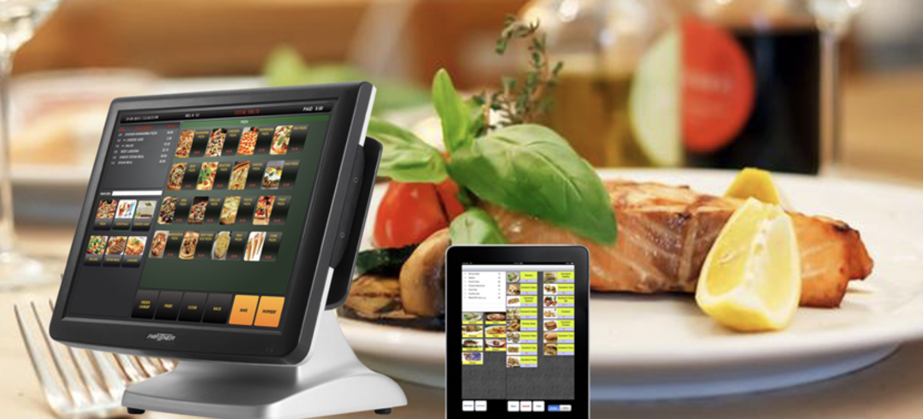







Tech Stack
ERD + Data Tables
DDL & DML
Stored Procedures + Triggers
UDFs + Views + Encryption
Data Visualization
Restaurant Management System

Slide 3
Objective
Our main objective is to design a database platform for Restaurants to help them solve real time issues like –
1. Inventory issues.
2. Demand-Supply related problems
3. Booking reservations
4. Online ordering, etc.
To make a data visualization dashboard that helps us understand the market equilibrium and an overview of managing Restaurant Business smoothly.

Slide 4
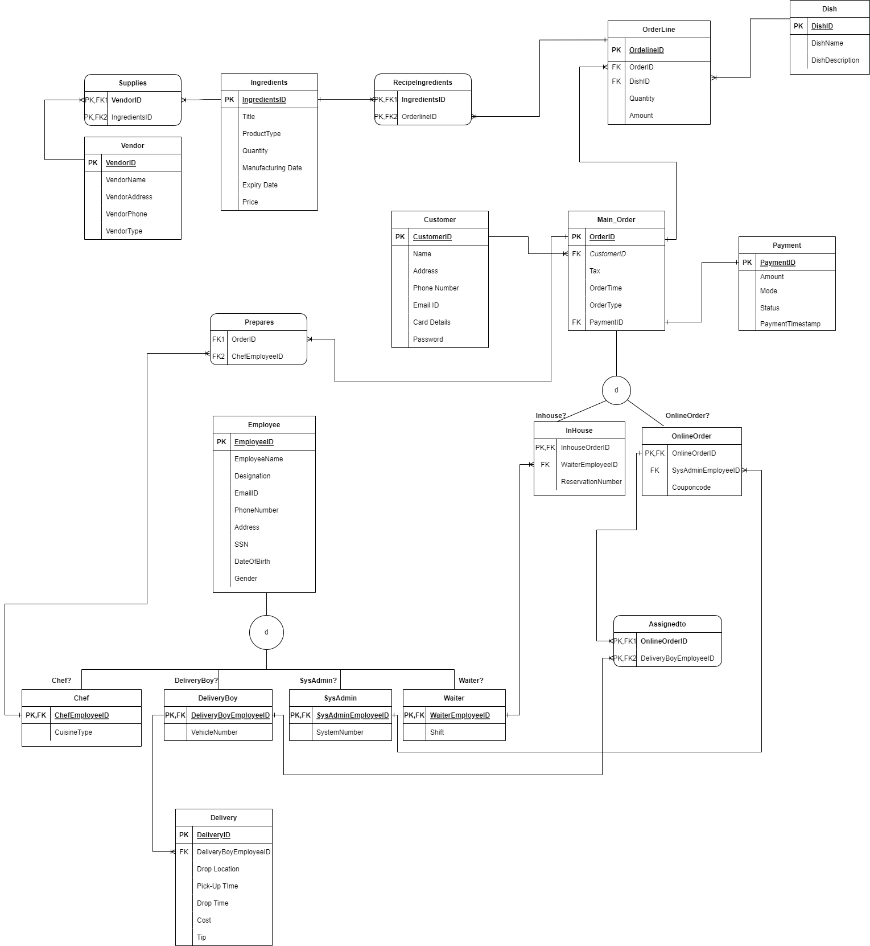
Entity Relationship Diagram

Slide 5
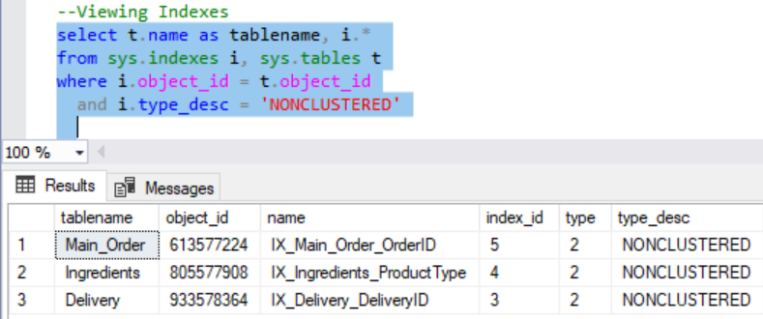
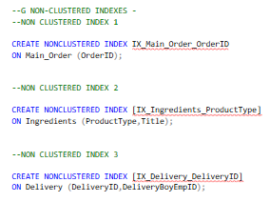
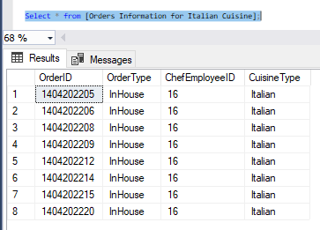
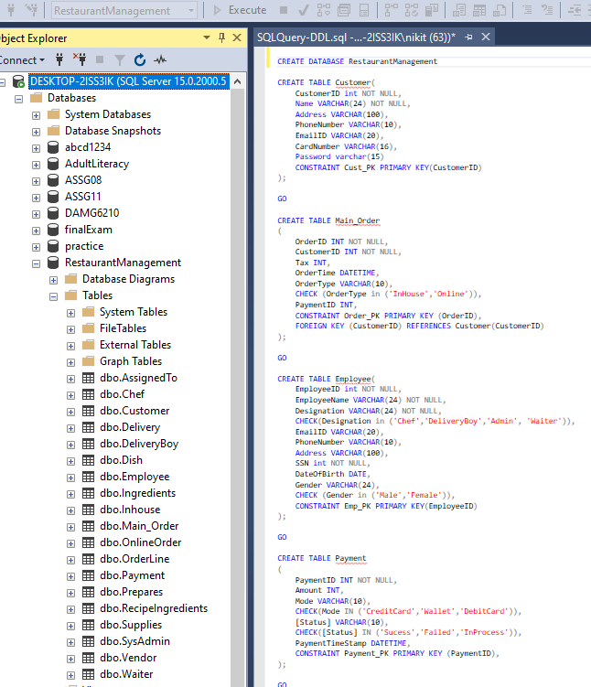
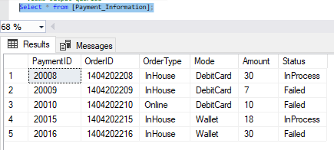
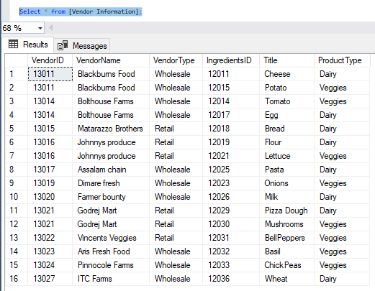
Total 19 Tables were created using “Create Table” query.
Out of 19, 4 were associative entities.
Two subtype-supertype relationships.
We have added 7 Table-level check constraints .
Database Objects
View 1 Orders Information for Italian Cuisine
Non-Clustered Indexes
View 2 Payment Information
View 3 Vendor Information

Slide 6
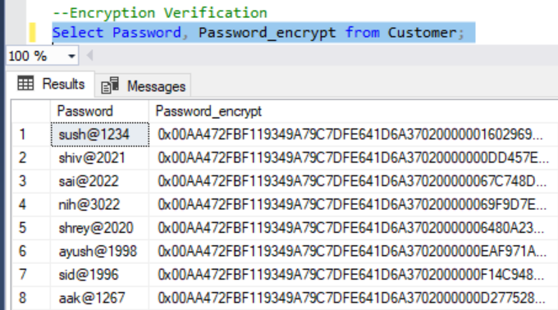
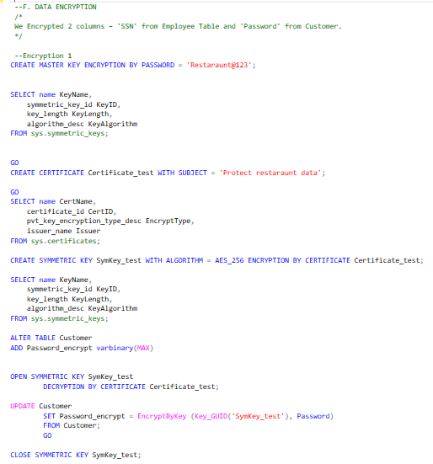
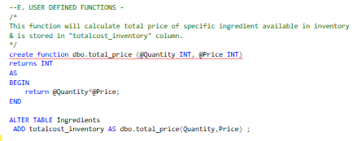
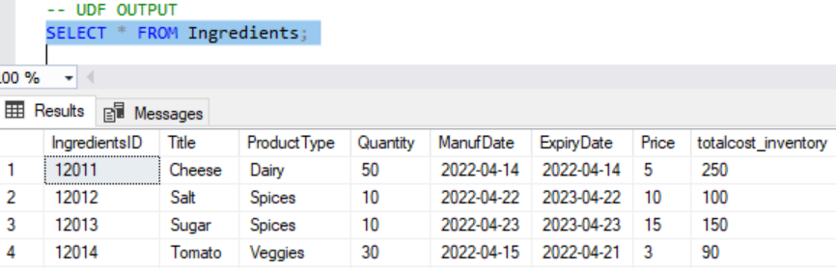
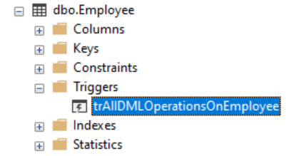
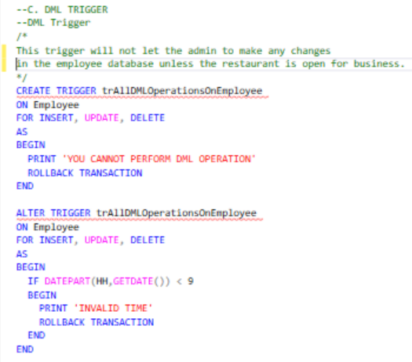
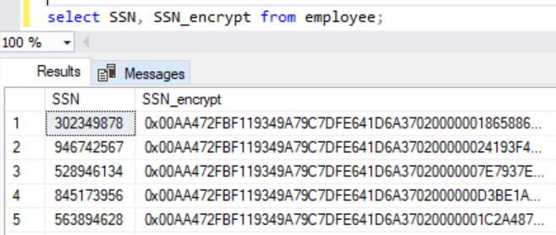
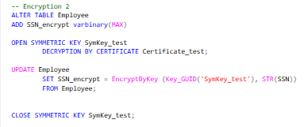
1. Encrypting Password Column
Database Objects
User Defined Functions
TRIGGERS
2. Encrypting SSN Column

Slide 7
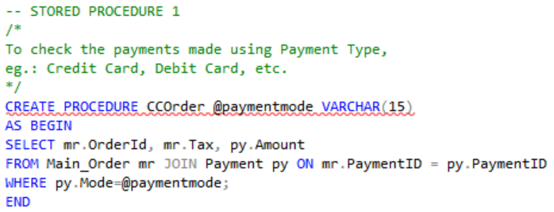
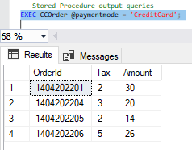
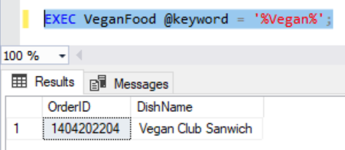
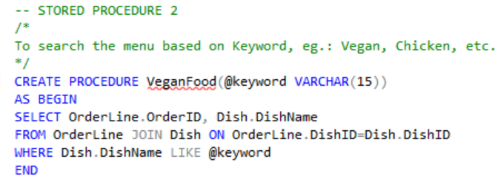
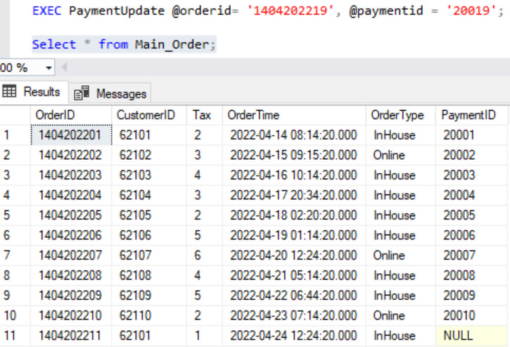
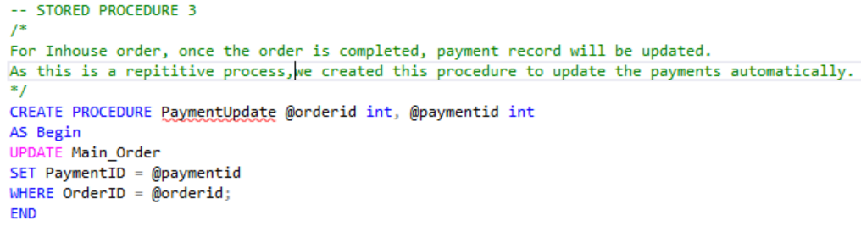
Stored Procedures

Slide 8
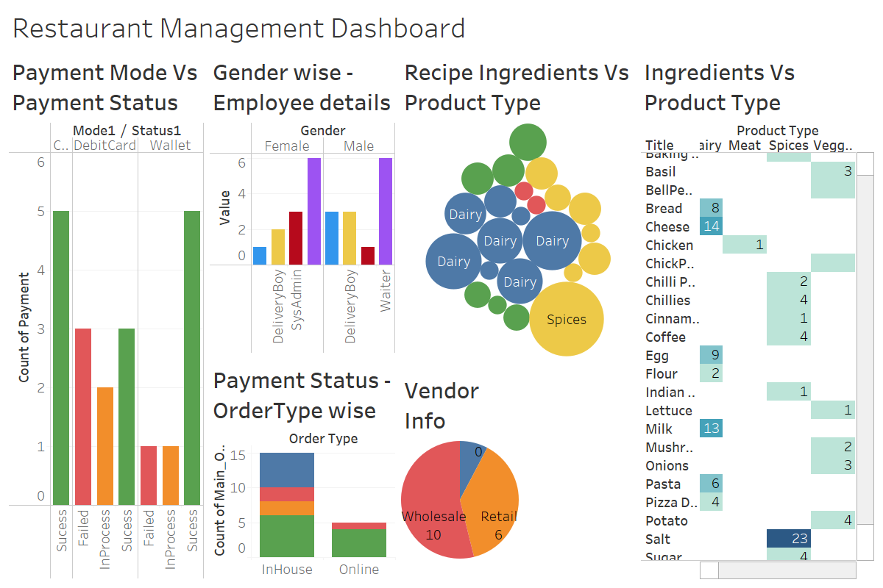

Data Visualization : Tableau
THANK YOU
8

